Slide 1
Fossil-Fuel CO2 Emissions (1950-2019)
Group 5
Rohit Anumolu
Esha Reddy
Rida Fathima
Fall 2022 - MSA 8020 - Data Visualization Final Project Presentation
November 29, 2022

Slide 2
Dataset Info

Slide 3
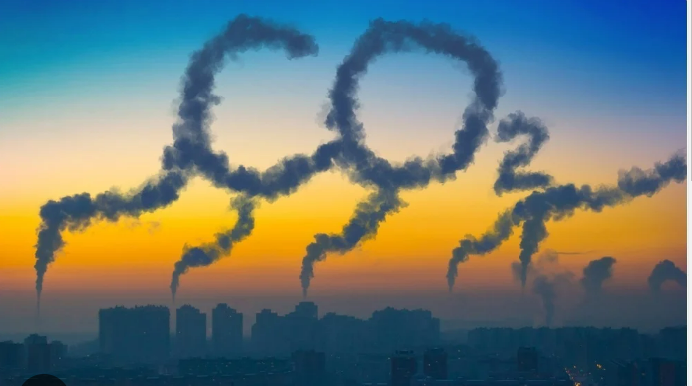
Global Fossil-Fuel CO2 Emissions
Data Source: https://energy.appstate.edu/cdiac-appstate/data-products
This data product is a time series of Carbon Dioxide (CO2) emissions from fossil fuel combustion and cement manufacture.
Estimates of CO2 emissions and other emissions due to different fuel consumptions (solid, liquid, gas fuel) are present - Nation wise, from 1751. It also includes the estimates of emissions from cement production and gas flaring .
Per capita CO2 emissions and emissions from international trade (bunker fuels) are included as well.
Notes:
Charanya

Slide 4
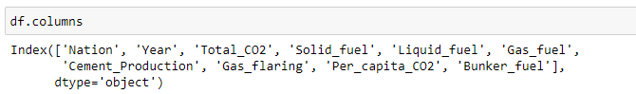
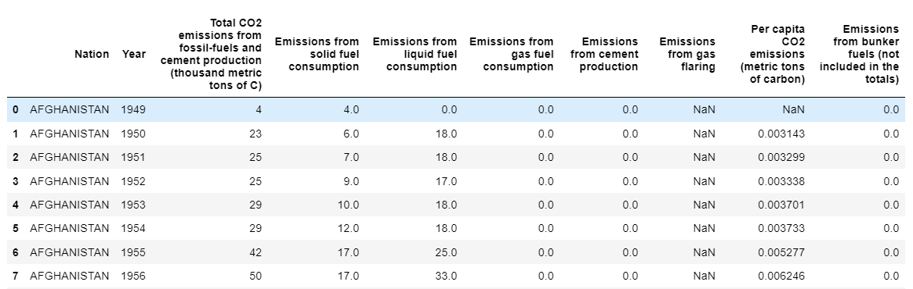
Fossil-Fuel CO2 Emissions of every Nation
Yearly data
Rows | 18547
Columns | 10
Start date: 1751
End date : 2019

Slide 5
Insights
Notes:
Sri

Slide 6
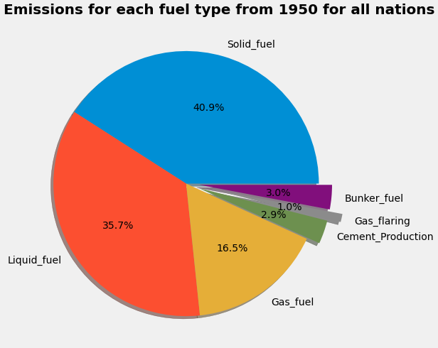
We can see the share of each fuel contributing to the overall CO2 emissions in the year 1950.
With solid fuel, followed by liquid fuel emitted the most, together contributing to a total of 76.6%.
Notes:
Charanya

Slide 7
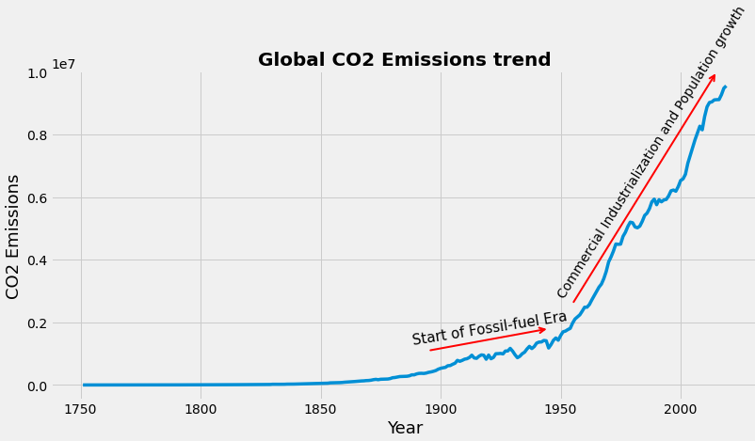
We can see that CO2 emissions started increasing in the 1900s, which was also marked by the start of the fossil-fuel era.
Later, emissions increased rapidly from 1960, due to industrialization and population growth.
Notes:
Charanya

Slide 8

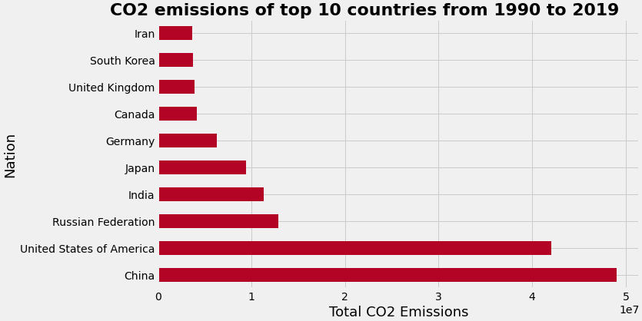
The world cloud shows the top 50 emitters from 1990.
The bar plot shows the top 10 countries with their emissions since past 3 decades.
China has produced the most CO2 emissions during the period 1990 to 2019, with almost 50M metric tons, followed closely by the United States of America 43M metric tons of CO2.
Notes:
Charanya

Slide 9
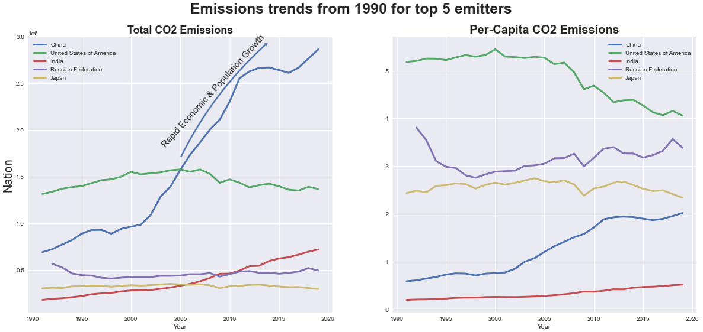
The Emissions trend shows that China’s emissions have shot up, while the other top e countries’ total emissions have stayed almost constant. India’s emissions also increased from 2010.
Similarly, the per capita emissions have also risen for China over the years, while it has decreased for the USA.
Notes:
Charanya

Slide 10
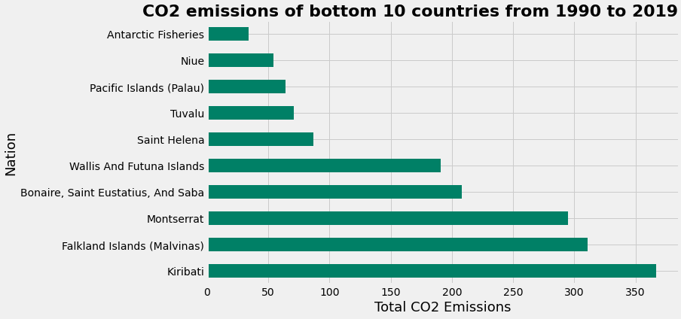
Antarctic Fisheries has produced the least CO2 emissions of around 40 metric tons, followed by Niue (an island in South Pacific Ocean) with emissions around 52 metric tons.
Notes:
Charanya

Slide 11
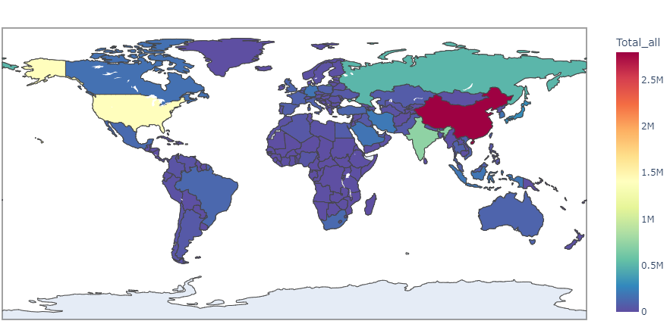
Total CO2 emissions Choropleth map
2019

Slide 12
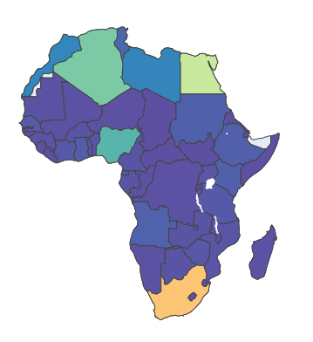
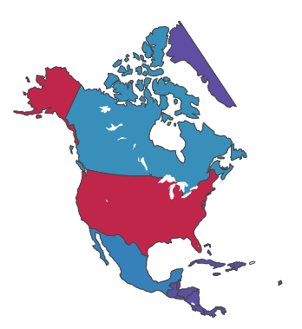
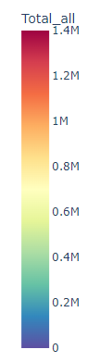
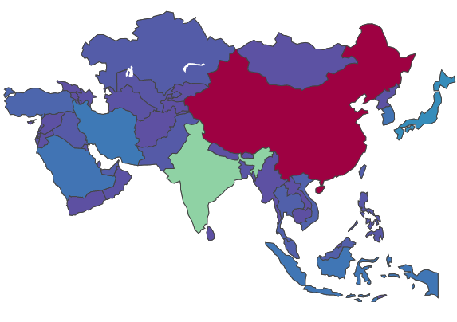
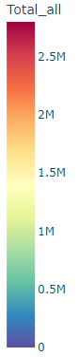
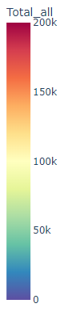
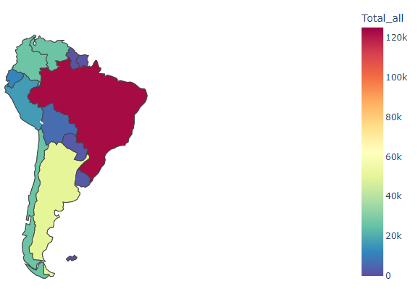
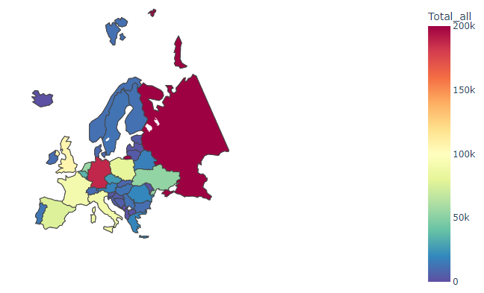
Continent wise choropleth map
Continent wise choropleth map of total CO2 emissions.
The color scale is with respect to that particular continent and not for all the countries in the globe

Slide 13
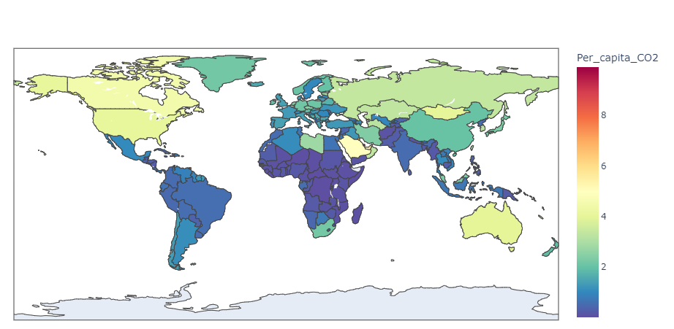
Per-Capita CO2 emissions Choropleth map
2019

Slide 14
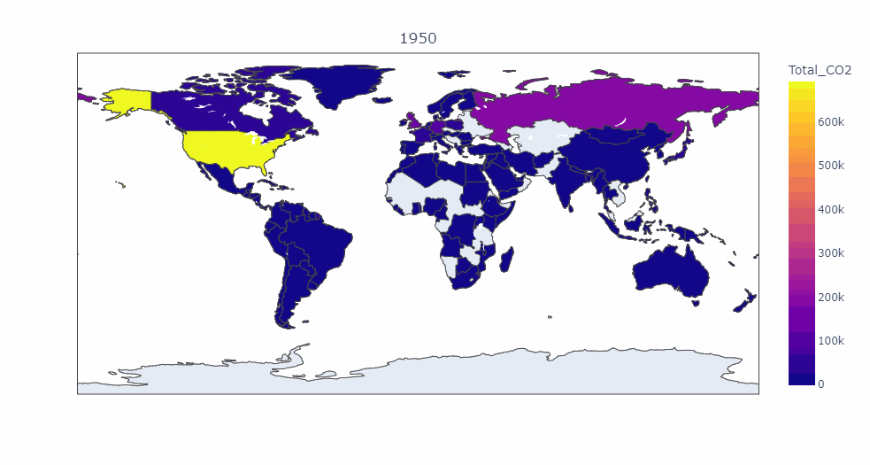
Total CO2 emissions Choropleth map Animation
5 year difference between each frame

Slide 15
Member Contribution

Slide 16
Member | Contribution
Esha Reddy | Emissions for each fuel type Global CO2 emissions trend
Rida Fathima | CO2 emissions for top and bottom 10 countries Emission trends for top 5 emitters
Rohit Anumolu | Choropleth plots Word Cloud Data Cleaning

Slide 17
Questions

Slide 18
Thank You!

